Slide 1
§9.2: n-ary Relations
An n-ary relation R on sets A₁,…,A_{n},
written (with signature) R:A₁×…×A_{n} or R:A₁,…,A_{n}, is simply a subset
R ⊆ A₁× … × A_{n}.
The sets A_{i} are called the domains of R.
The degree of R is n.
R is functional in the domain A_{i} if it contains at most one n-tuple (…, a_{i} ,…) for any value a_{i} within domain A_{i}.
*
School of Computer Science, BUPT
*

Slide 2
Example 1~2
  Let R be the relation on N×N×N consisting of triples (a, b, c), where a, b, and c are integers with a < b < c.
  Let R be the relation on Z×Z×Z consisting of all triples of integers (a, b, c) in which a, b, and c form an arithmetic progression. That is, (a, b, c) ∈ R if and only if there is an integer k such that b = a + k and c = a + 2k, or equivalently, such that b − a = k and c − b = k.
*
School of Computer Science, BUPT
*

Slide 3
Example 3~4
Let R be the relation on Z×Z×Z⁺ consisting of triples (a, b, m), where a, b, and m are integers with m ≥ 1 and a ≡ b (mod m).
Let R be the relation consisting of 5-tuples (A,N, S,D, T ) representing airplane flights,where A is the airline, N is the flight number, S is the starting point, D is the destination, and T is the departure time.
*
School of Computer Science, BUPT
*

Slide 4
Relational Databases
A relational database is essentially just an n-ary relation R.
A domain A_{i} is a primary key for the database if the relation R is functional in A_{i}.
A composite key for the database is a set of domains {A_{i}, A_{j}, …} such that R contains at most 1 n-tuple (…,a_{i},…,a_{j},…) for each composite value (a_{i}, a_{j},…)∈A_{i}×A_{j}×…
*
School of Computer Science, BUPT
*

Slide 5
Relational databases
A model for databases, based on relations
A database is viewed as a collection of records, each being a tuple of the form (value₁, value₂, ..., value_{n})
Because this relation is often given as a table, this term (table) is used as an equivalent for relation in database terminology

Slide 6
Database intension and extension
The fields of the database (the columns) correspond to the domains of the relation
The number of fields is the degree n
The intension of the database (or its schema) is the permanent part of its design, i.e., the fields and the constraints on them
The extension of the database is its current population of records

Slide 7
Database keys
In order to uniquely identify tuples in a database, we need to know where to look, that is specify a field that serves for this purpose. This is the primary key.
Care must be taken to maintain the key property when inserting records
Some databases may have no primary key; instead they use a composite key made up from multiple fields
  A flight database: key = airline + flight number

Slide 8
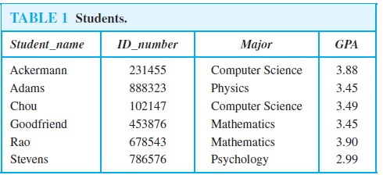
Example
Example 5
  Which domains are primary keys for the n-ary relation displayed in Table 1, assuming that no n-tuples will be added in the future?
Example 6
  Is the Cartesian product of the domain of major fields of study and the domain of GPAs acomposite key for the n-ary relation from Table 1, assuming that no n-tuples are ever added?
*
School of Computer Science, BUPT
*

Slide 9
Selection Operators
Let A be any n-ary domain A=A₁×…×A_{n}, and let C:A→{T,F} be any condition (predicate) on elements (n-tuples) of A.
Then, the selection operator s_{C} is the operator that maps any (n-ary) relation R on A to the n-ary relation of all n-tuples from R that satisfy C.
  I.e., ∀R⊆A, s_{C}(R) = {a∈R | s_{C}(a) = T}
*
School of Computer Science, BUPT
*

Slide 10
Selection Operator Example
Suppose we have a domain
A = StudentName × Standing × SocSecNos
Suppose we define a certain condition on A, UpperLevel(name,standing,ssn) :≡
[(standing = junior) ∨ (standing = senior)]
Then, s_{UpperLevel} is the selection operator that takes any relation R on A (database of students) and produces a relation consisting of just the upper-level classes (juniors and seniors).
*
School of Computer Science, BUPT
*

Slide 11
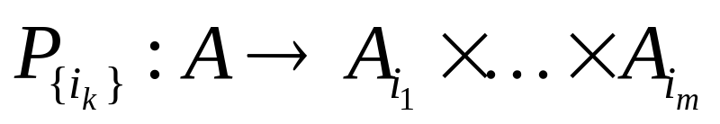
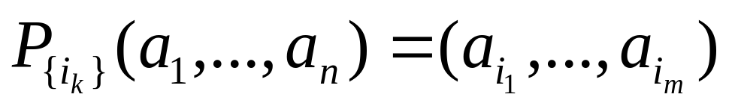
Projection Operators
Let A = A₁×…×A_{n} be any n-ary domain, and let {i_{k}}=(i₁,…,i_{m}) be a sequence of indices all falling in the range 1 to n,
  That is, where 1 ≤ i_{k} ≤ n for all 1 ≤ k ≤ m.
Then the projection operator on n-tuples
is defined by:
*
School of Computer Science, BUPT
*

Slide 12
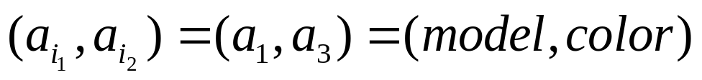
Projection Example
Suppose we have a ternary (3-ary) domain Cars=Model×Year×Color. (note n=3).
Consider the index sequence {i_{k}}= 1,3. (m=2)
Then the projection P simply maps each tuple (a₁,a₂,a₃) = (model,year,color) to its image:
This operator can be usefully applied to a whole relation R⊆Cars (a database of cars) to obtain a list of the model/color combinations available.
{i_{k}}
*
School of Computer Science, BUPT
*

Slide 13
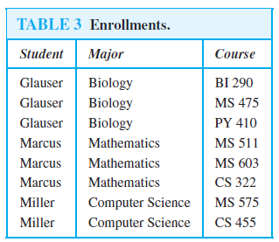
Example
Example 8
  What results when the projection P_{1,3} is applied to the 4-tuples (2, 3, 0, 4),(Jane Doe, 234111001, Geography, 3.14), and (a1, a2, a3, a4)?
Example 10
  What is the table obtained when the projection P_{1,2} is applied to the relation in Table 3?
*
School of Computer Science, BUPT
*

Slide 14
Join Operator
Puts two relations together to form a sort of combined relation.
If the tuple (A,B) appears in R₁, and the tuple (B,C) appears in R₂, then the tuple (A,B,C) appears in the join J(R₁,R₂).
  A, B, and C here can also be sequences of elements (across multiple fields), not just single elements.
*
School of Computer Science, BUPT
*

Slide 15
Join Example
Suppose R₁ is a teaching assignment table, relating Professors to Courses.
Suppose R₂ is a room assignment table relating Courses to Rooms,Times.
Then J(R₁,R₂) is like your class schedule, listing (professor,course,room,time).
*
School of Computer Science, BUPT
*

Slide 16
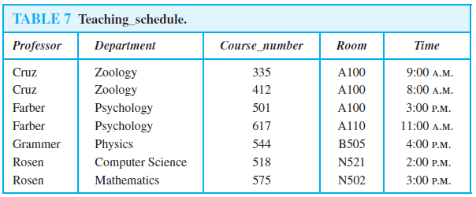
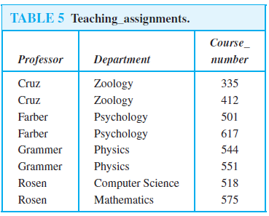
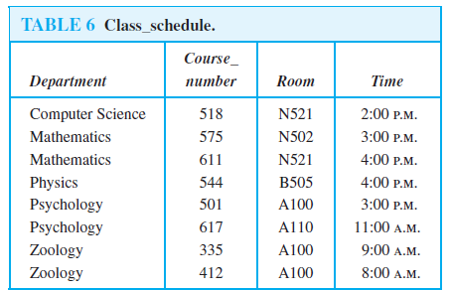
Example 11
  What relation results when the join operator J2 is used to combine the relation displayed in Tables 5 and 6?
*
School of Computer Science, BUPT
*

Slide 17
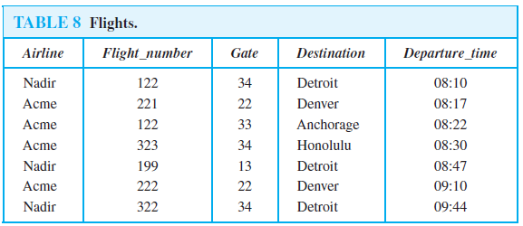
Sql
Example 12
  The SQL statement
    SELECT Departure_time
    FROM Flights
    WHERE Destination=‘Detroit’
*
School of Computer Science, BUPT
*

Slide 18
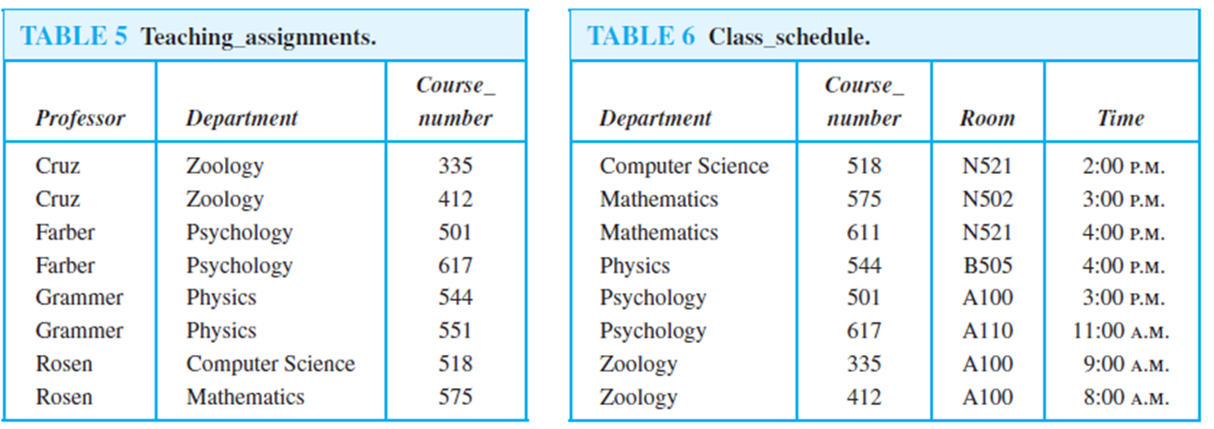
Example 13
  The SQL statement
    SELECT Professor, Time
    FROM Teaching_assignments, Class_schedule
    WHERE Department=’Mathematics’
*
School of Computer Science, BUPT
*

Slide 19
Homework
§9.2
  8, 20
*
School of Computer Science, BUPT
*

